Slide 1

Pair-Navi Peer-to-Peer Indoor Navigation with Mobile Visual SLAM
Erqun Dong*, Jingao Xu*,
Chenshu Wu†, Yunhao Liu*‡, Zheng Yang*
*School of Software and BNRist, Tsinghua University
†University of Maryland, College Park
‡Michigan State University
May 1, Paris, France
Notes:
Thanks for the introduction.
Good afternoon, I am Erqun Dong from Tsinghua University. Today, I want to share with you our recent work, Pair-navi: Peer-to-Peer Indoor Navigation with Mobile Visual SLAM.

Slide 2
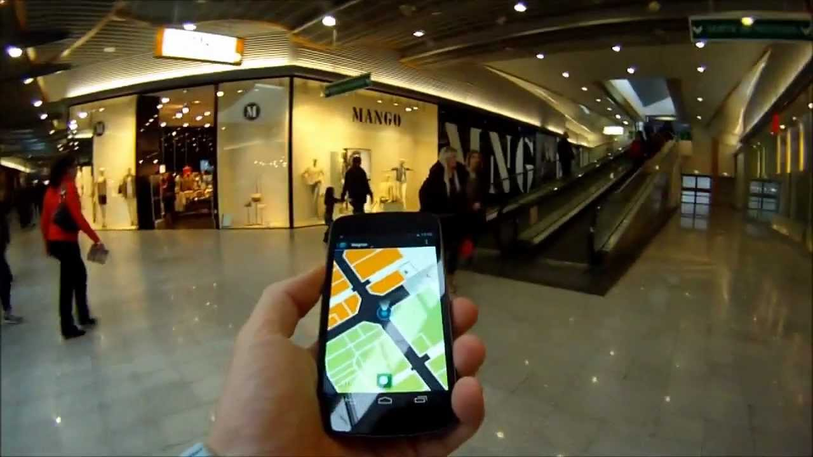
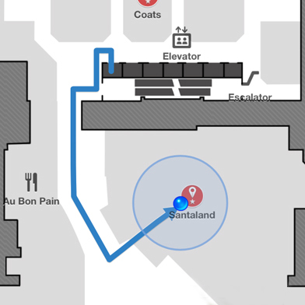
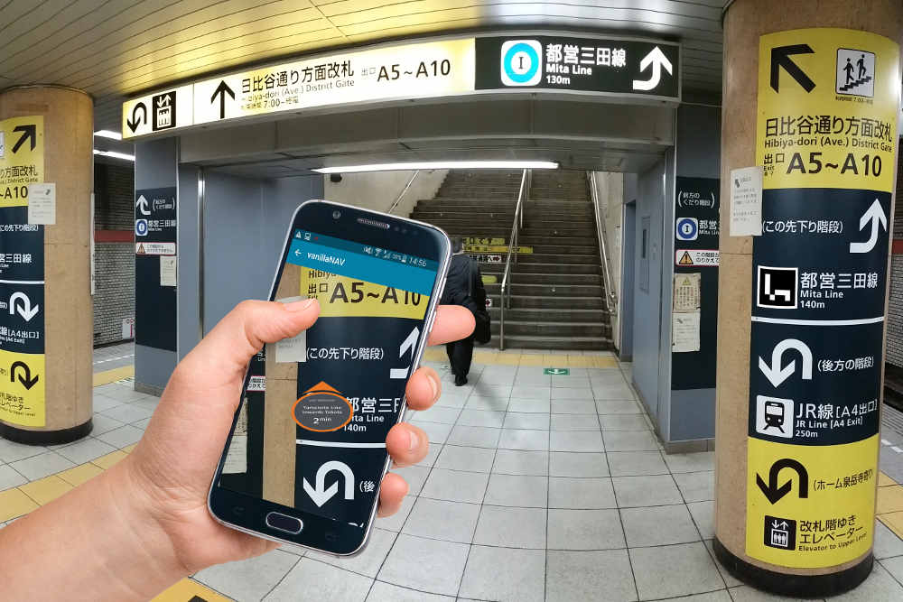

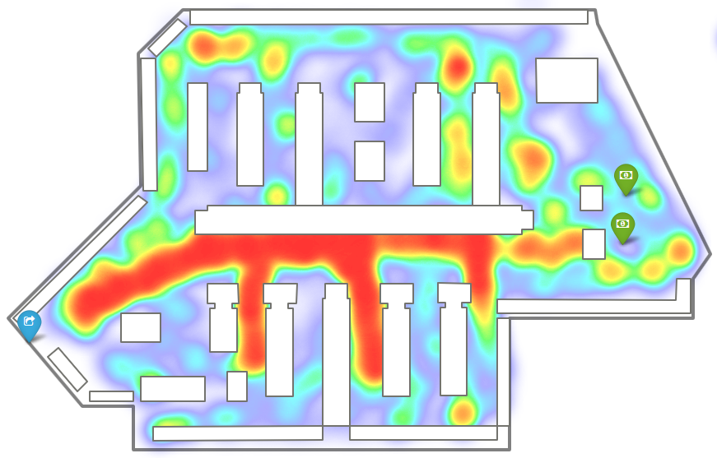

Motivation
Indoor Navigation is going to be commercialized
Commercial value behind indoor navigation
Destination selection
Route planning
Navigation instruction
Customers
PoI discovery
Merchant recommendation
Notes:
Indoor Navigation is going to be commercialized,
[click] a user can select a destination, get a planned route and receive navigation instructions.
[click] Potential value lies behind indoor navigation, shop owners can get more customers coming, the shopping mall can find Places of Interest, and do Merchant Recommendation to customers.

Slide 3
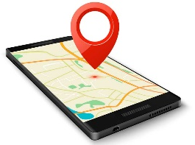

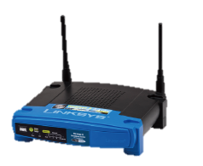


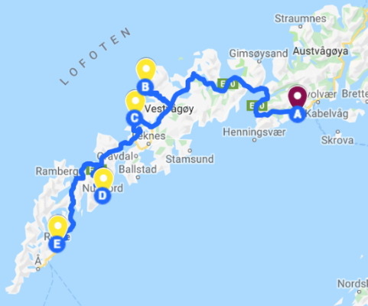

Motivation
Traditional key components of navigation
Traditional key components of navigation are infeasible in indoor environment.
Outdoor
Indoor
LOW ACCURACY
Localization
GPS
RSS Fingerprint
LOW AVAILABILITY
Map
Google Map
Indoor Floorplan
LOW SEMANTICS
Route
planning
Road Network
Accessible Area
Notes:
In traditional view, navigation consists of mainly three parts,
[click] localization, map and route planning.
While outdoor navigation has already entered commercial stage, indoor navigation is still limited.
[click] First, as for localization, outdoor applications use GPS, but indoor navigations are mainly based on wireless signals that are not accurate enough.
[click] Second, as for maps, outdoors we already have Google Map, but most indoor environments does not have an electronic floorplan.
[click] Third, as for route planning, outdoor route planning can be conducted on Road Networks, which has abundant semantic information, but indoor route planning based on accessible areas has low semantic information.

Slide 4


Motivation
(Indoor) Navigation := Localization + Map + Route?
Localization accuracy?
Map availability?
Path semantics?
Self-motivated users
Shop owners, early comers
Build a path
Others follow the path
(Indoor) Navigation := Leader + Follower
Notes:
But are these three factors,
[click] localization, map and route, really necessary?
[click] Recently, the traditional concept of navigation is challenged by a new mode where self-motivated users, such as shop owners in a big mall, early comers of a dinner, can build a navigation path, and a user in need of navigation can just follow the path to reach the destination.
This mode is called a leader-follower mode, or a peer-to-peer mode.

Slide 5
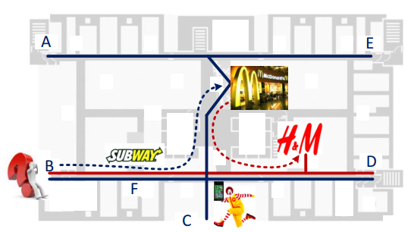
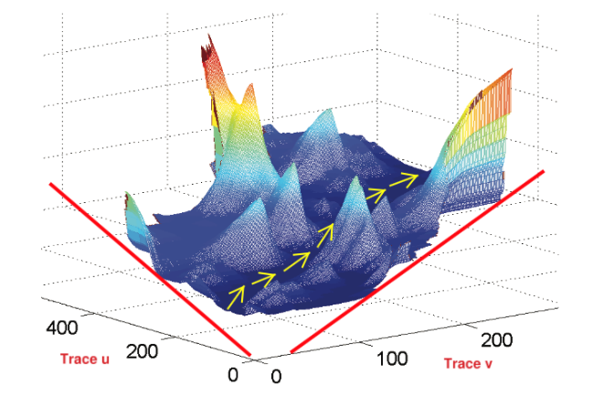
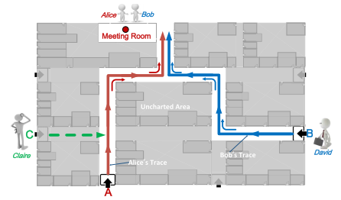
Existing Works-P2P Navigation
Travi-Navi, Mobicom ’14
Followme, Mobicom ’15
ppNav, JSAC’17
Although having achieved navigation, these systems using inaccurate wireless localization are prone to failure and
not user-friendly
Notes:
Existing works of peer2peer navigation include Travi-navi, Followme and ppNav.
[click] Although having achieved navigation, these solutions using inaccurate wireless localization are prone to failure and not user-friendly, because the follower is not aware of where he is.

Slide 6
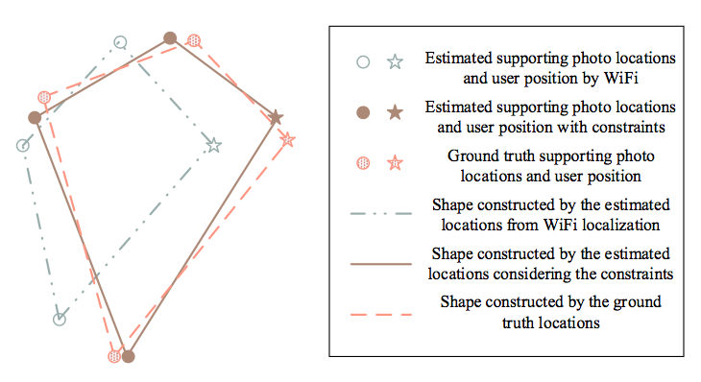
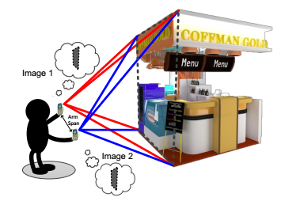
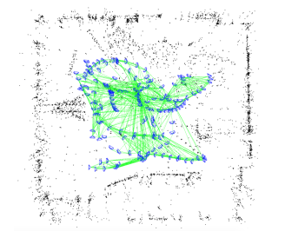
Existing Works-Visual Localization
Argus, UbiComp’15
ClickLoc, UbiComp’16
ORB-SLAM, ToR’17
High-accuracy but
vulnerable to dynamic environment and
high computational complexity
Notes:
Another trend in indoor localization and navigation is to turn to the power of vision.
For example, Argus uses structure from motion to localize, ClickLoc use line feature for geometry reasoning.
Also, works in SLAM field is highly relative to our interest, among which ORB-SLAM is one of the state-of-the-arts.
[click] But these works are vulnerable to dynamic environment, and pure SLAM has high computational complexity in mobile devices.

Slide 7
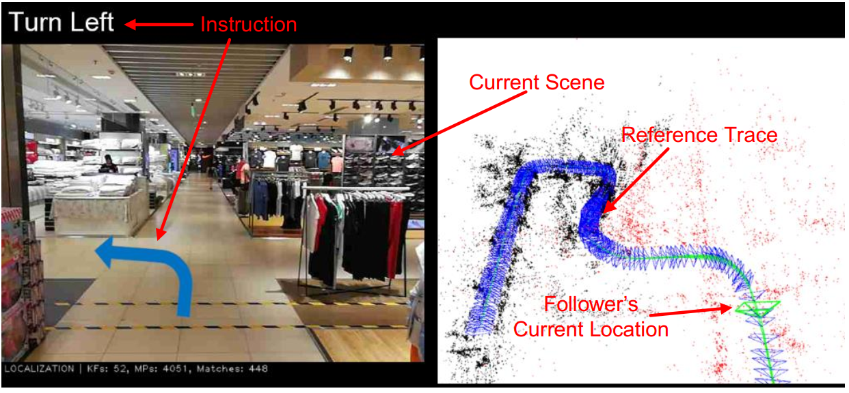
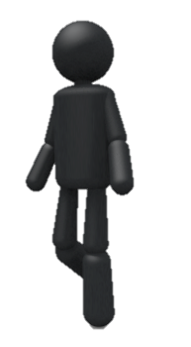
Problem Statement
An Indoor Navigation system using Mobile Vision.
User-friendly, high-accuracy and high-robustness
Resistant to dynamic environment and crowded situation
A real time navigation system
Leader
Follower
Notes:
Based on the above inspirations, we developed our visual Peer2Peer navigation system.
[click] Our system is user-friendly, has high accuracy and high robustness.
[click] Plus, our system is resistant to dynamic environmant, especially crowded situation.
[click] Last but not least, it navigates in real-time.

Slide 8
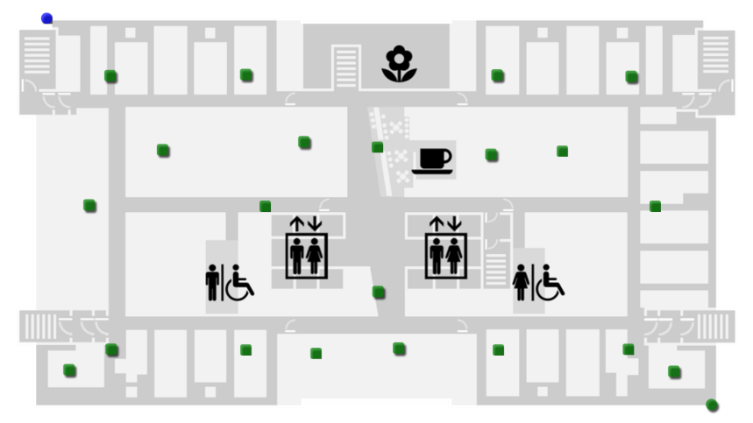



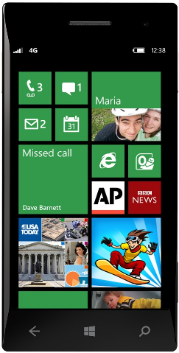




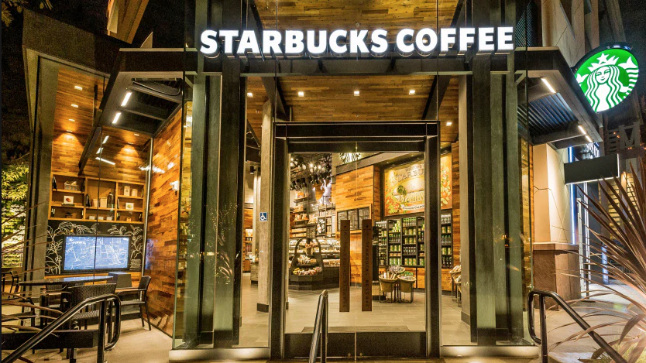
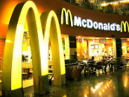
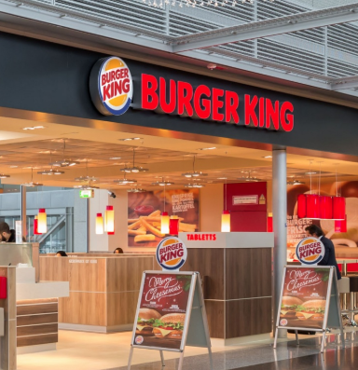
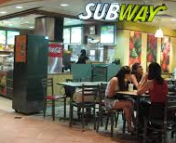
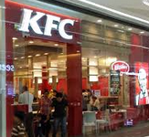
System Workflow - Leader
Leader’s Indoor Trajectory
Generated Trajectory Map
Trajectory
Key-frame
Notes:
Now here is a demonstration of the work flow.
Let’s suggest the leader works in the MacDonald’s over here.
He wants to build a path from the front gate of the mall to the MacDonald’s.
[click] For example, this is the path he chooses.
He should pass a SUBWAY, a KFC, a Starbucks, a Burger King and finally reaches the MacDonald’s.
So he walks along his path and shoots the video, our system will generate his trajectory as well as saving the keyframes on the path.

Slide 9
System Workflow - Follower
Navigation for Follower
Reference Trajectory
Trajectory
Key-frame
Notes:
When a follower wants to go the the MacDonald’s from the front gate.
He gets the leader's trajectory from the server, and opens his camera.
Our system will relocalize his camera in the leader’s trajectory,
[click] meanwhile giving navigation instructions according to his relative position in the trajectory.
For example, if he reaches the KFC, then our system will tell him to turn left. And if he is at the Starbucks, then our system will tell him to turn right.

Slide 10
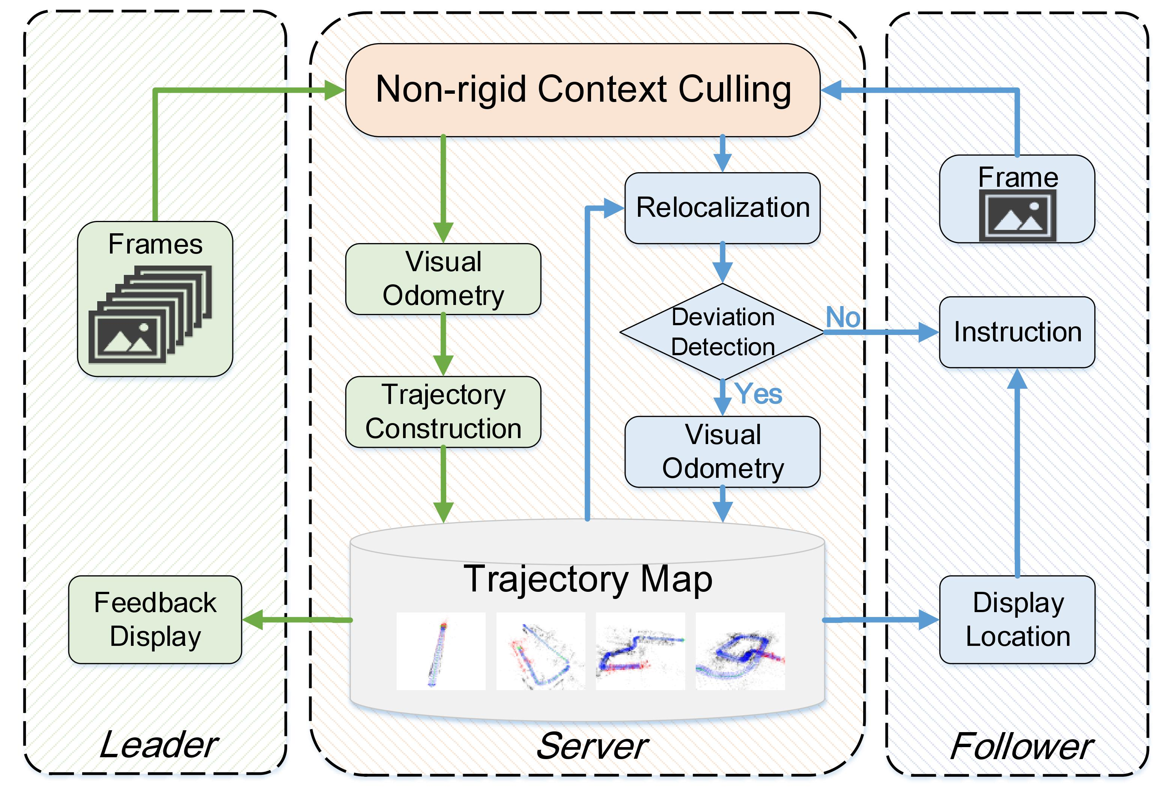
System Design
Notes:
Now let's look at more detailed system designs.
Here is the overall architecture. It's a mobile-to-server architecture. (In practical usage, this can be deployed as an edge computing structure.)
In the leader’s side, our system mainly carries out visual odometry to construct trajectory. In the follower’s side, our system relocalizes his camera in the leader’s trajectory and guides the follower to the destination.

Slide 11
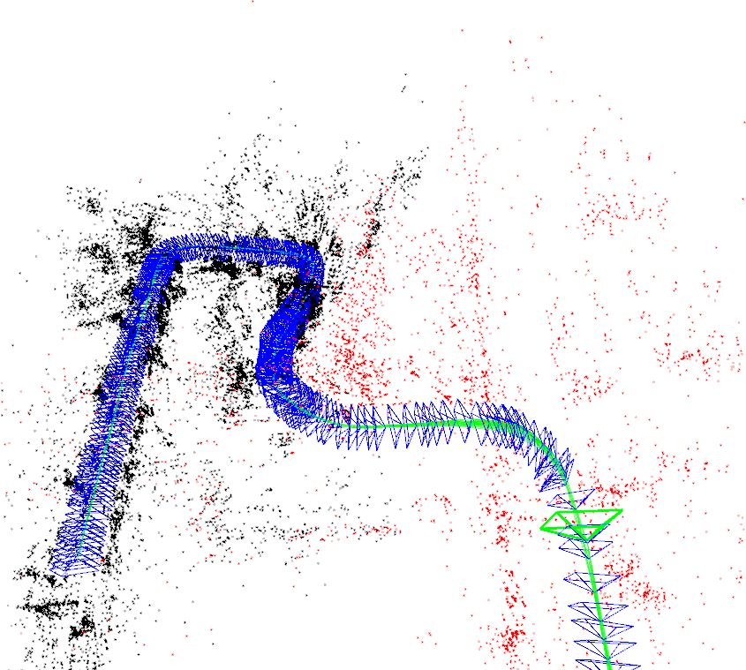
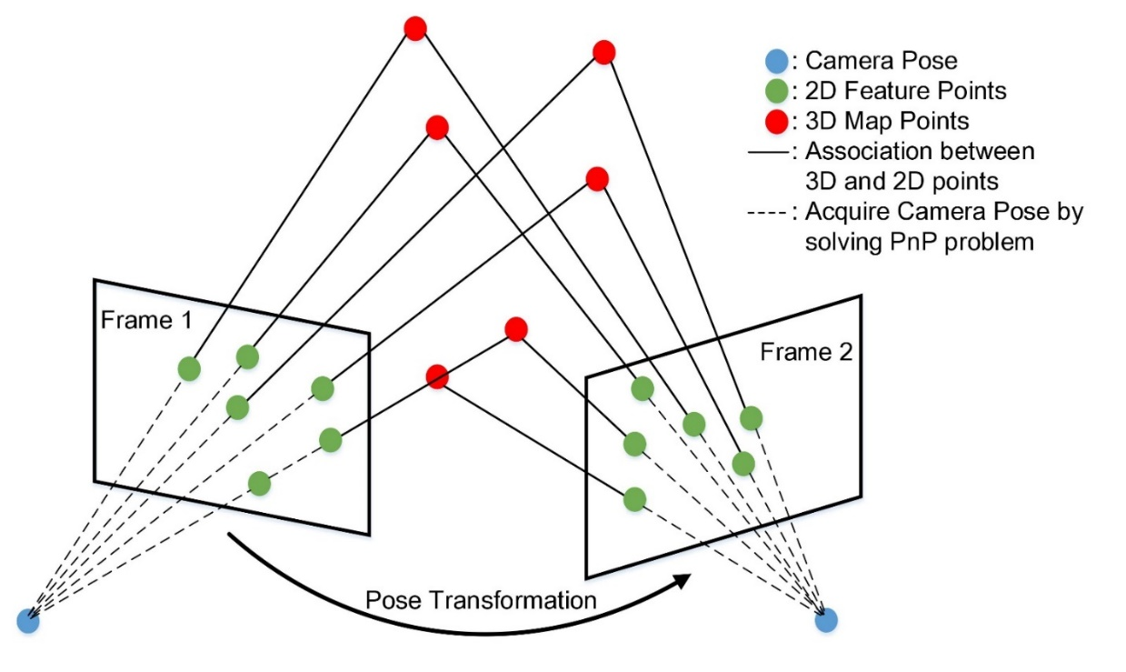
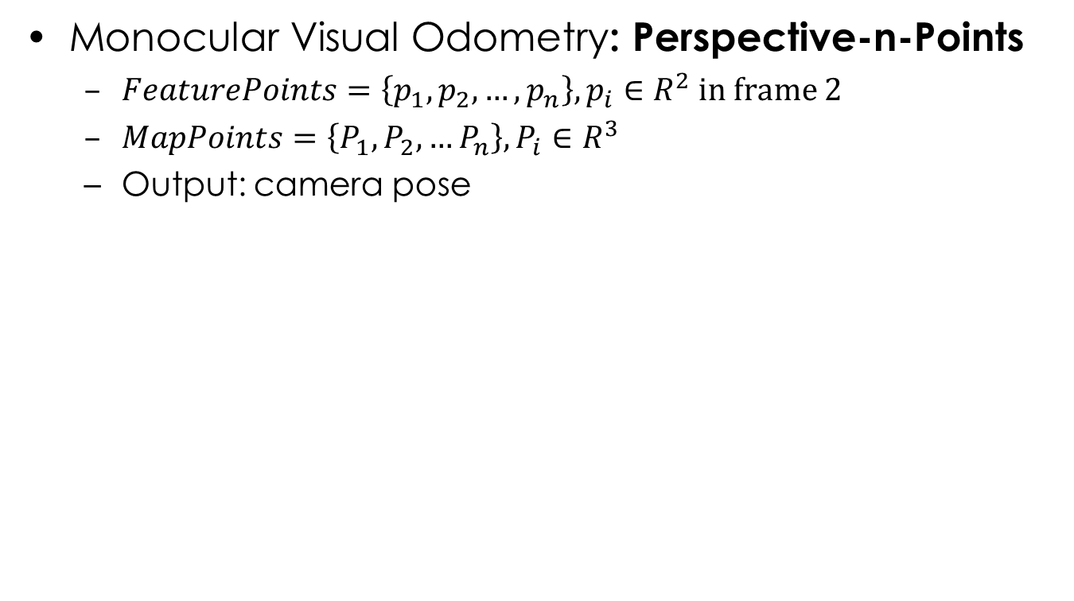
Leader: Trajectory Construction
Monocular Visual Odometry: Perspective-n-Points
$FeaturePoints=\left\{p_{1},p_{2},…,p_{n}\right\},p_{i}∈R^{2}$ in frame 2
$MapPoints=\left\{P_{1},P_{2},…P_{n}\right\},P_{i}∈R^{3}$
Output: camera pose
Notes:
First let’s see how a leader constructs the trajectory. It’s called monocular visual odometry.
Given frame 1 with some feature points that have associated 3D Map Points, if frame 2 has feature points matched to those in frame 1, then the points in frame 2 are also associated to the 3D map points.
[click] So we have two sets of points: 2D feature points in frame 2, and their corresponding 3D map points, and this is when we can do a Perspective-n-points algorithm.
[click] It takes these 2D-3D data as input, and calculates the pose of camera frame.
[click] By continuously doing this, we can get a sequence of poses, which is exactly the trajectory of camera, and we also have a sequence of keyframes and a map of 3D Points. In the right figure, these blue things are keyframes, these black and red points are map points.

Slide 12
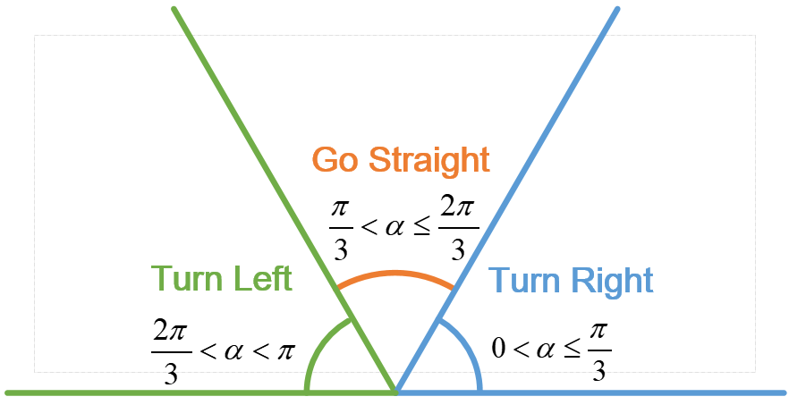

Follower: Navigation
Relocalize the follower in the leader’s trajectory
Calculate the navigation instruction
Reference trajectory
Next 10 frames
Current Pose
Next Step
Notes:
Next, let’s see how the system navigates a follower. Suppose now comes a follower going to travel the same path as a leader, here’s the reference trajectory.
[click] We continuously relocalize the follower’s camera in the leader’s trajectory. By feature point matching, we can find a most similar keyframe of the leader’s, and again, do a Perspective-n-points to get the follower’s camera pose with respect to the leader’s trajectory.
[click] Then, we take the poses of the next ten keyframes, average them as the step next to go.
[click] There’s an angle between this next step and the current viewing angle, right?
[click] According to this angle, we can give the instructions like “Go forward, turn left, turn right” .

Slide 13
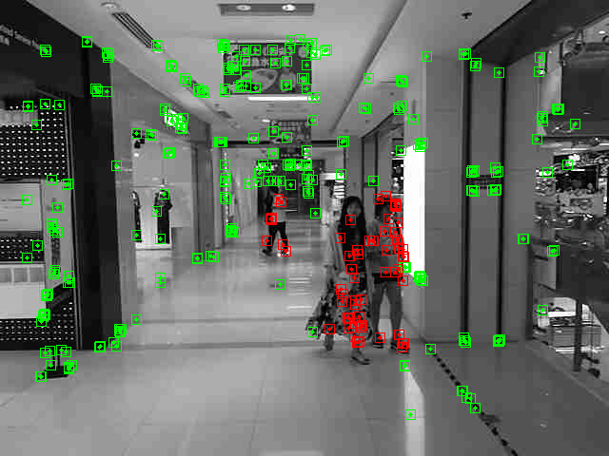
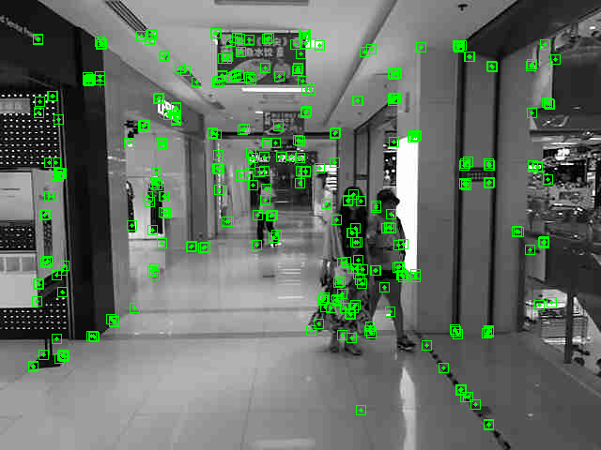
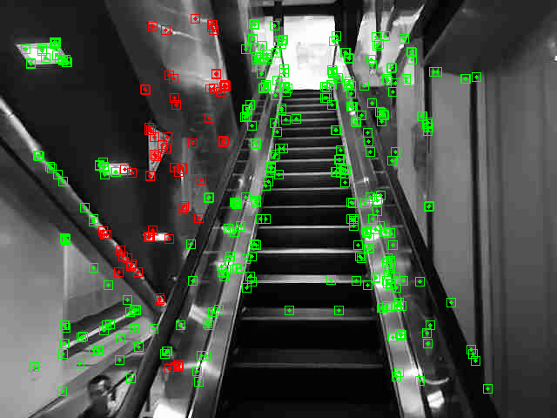
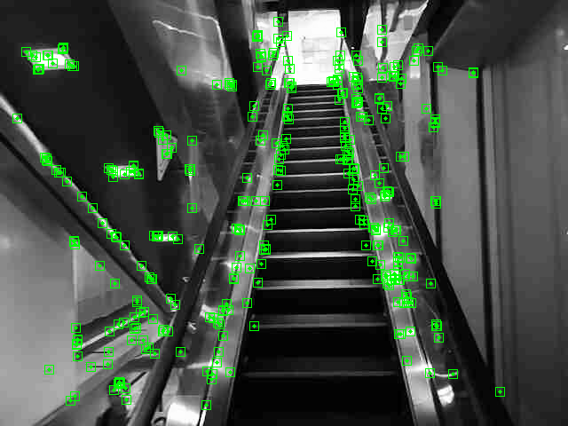
Non-rigid Context Culling
Using Mask-RCNN and mirror reflection in Yolo
Notes:
OK, that’s basically how the navigation works.
To put the system into practical usage, there is still one big challenge.
The intended indoor navigation scenario includes highly dynamic objects such as people walking around and things movable.
For the non-rigid context challenge, we leverage Mask R-CNN. Mask R-CNN segments objects in pixel level. It tells whether a feature point belongs to the non-rigid context.
Moreover, we incorporate the mirror reflection detection in Yolo, because the feature points from mirror reflection areas are changable due to lighting conditions, so they are also in non-rigid context.
We cull out these points in non-rigid context and keep the remaining ones.
For example, the red feature points on people and from the mirror reflection areas on an escalator are excluded by our system.

Slide 14
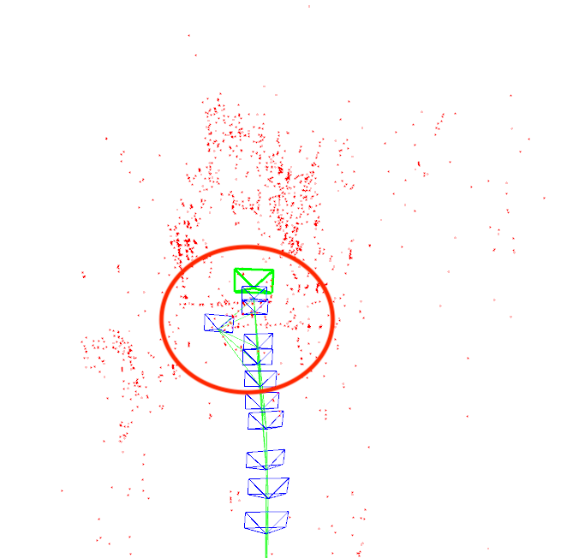
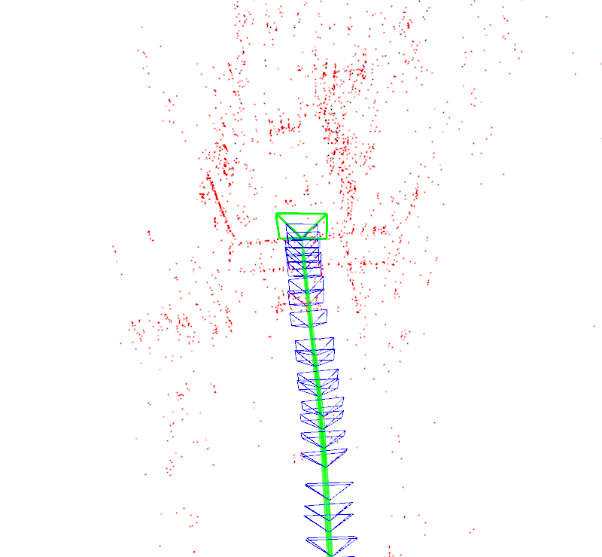
Non-rigid Context Culling
Accurate trajectory and robust relocalization
Example: Trajectory of a straight line.
Without NRCC
With NRCC
Notes:
Now here is an example demonstrating the importance of non-rigid context culling. What non-rigid context culling does is assuring the trajectory accuracy as well as relocalization robustness.
[click] These two trajectories built from the same video, in which the leader is walking in a straight line.
Without non-rigid context culling, there is a spike in the trajectory because a pedestrian moved in and out the scene when the leader was shooting the video.
However, with non-rigid context culling, the trajectory is well-constructed to be a line.

Slide 15
Real-time strategy
0.1s
Frame 1
Calculate Mask
0.2s
Frame 2
Non-rigid culling
Mask of frame 1
Used for frame 3&4
0.3s
Frame 3
0.4s
Frame 4
0.5s
Frame 5
Mask of frame 3
Used for frame 5&6
0.6s
Frame 6
Timeline
Notes:
But how to run navigation with Mask R-CNN in real-time?
By real-time, we mean at least 10 frames per second, the typical frame rate of persistence of vision.
[click] While navigation can satisfy the 10-frame-per-second requirement, Mask R-CNN can only run in our server at 5 frames per second in average.
[click] So here’s our strategy: we use 1 Mask frame for 2 frames of navigation. It introduces some error with this 0.2s time gap, right? However, we noticed that pedestrains cannot make too much move in this short time. So, basically this 1-mask-frame-for-2-frames-of-navigation strategy is feasible.

Slide 16
Is it enough? We also need Deviation detection
Notes:
Last but not least, current state-of-the-art peer2peer navigation system cannot handle follower deviations.
If a follower deviates from the leader’s trajectory, then the navigation is doomed.

Slide 17
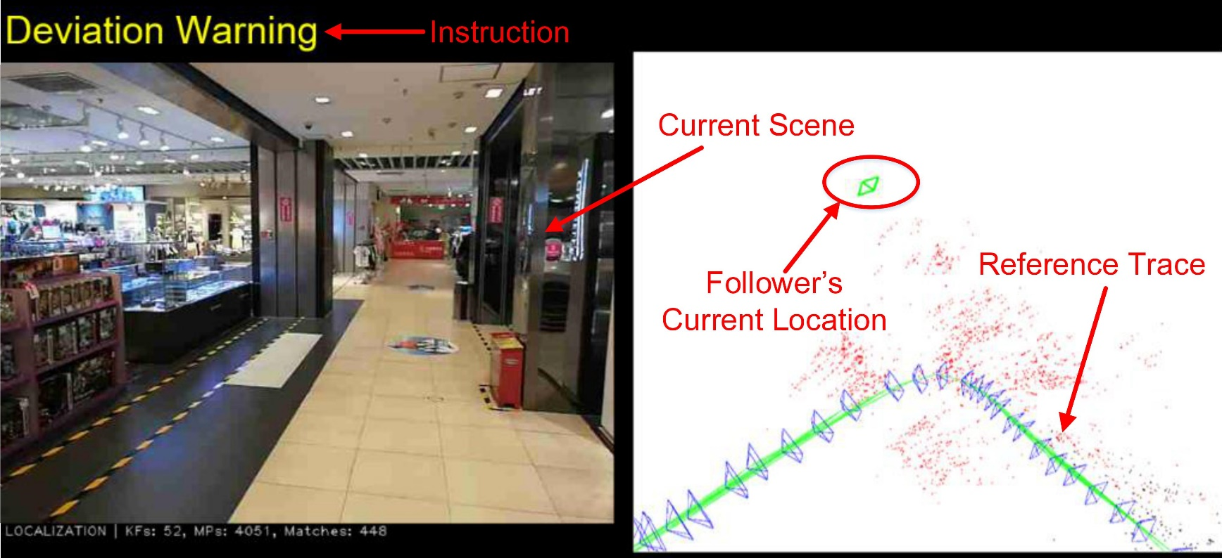
Follower: Deviation Handling
Auxiliary Visual Odometry
Launches when the relocalization is tenuous
Maintains tracking of the current camera pose
Hands back the control to relocalization
Notes:
In our visual navigation scenario, the relocalization may fail because few map points are observed.
[click] We designed an auxiliary visual odometry to handle follower deviation. When the relocalization has few matched map points, we launch the auxiliary visual odomery to maintain tracking of the current camera pose and guide the follower back to the leader’s trace.
For example, this is the GUI on the phone when deviation happens. The auxiliary visual odometry tracks the follower’s current camera frame outside the leader’s trajectory. And a follower is aware how much distance and to which angle he has deviated, so he can easily go back to the trajectory.
Once the relocalization observes adequate map points again, the auxiliary visual odometry shuts down and the navigation resumes.

Slide 18
Experiments: Settings
Venues
Office building, gym, shopping mall
Data collection
6 short paths(<100m), 7 medium paths(100m-200m) and 8 long paths(>200m)
Comparison
Travi-navi (Mobicom’ 14), FollowMe (Mobicom’ 15)
Evaluation Metrics
Navigation success rate
Notes:
Next, let’s see the experiments.
The venues are an office building, a gym and a shopping mall.
We collected 6 short paths, 7 medium paths and 8 long paths.
For performance comparison, we compared our work to Travi-navi and FollowMe.
We use Navigation success rate as evaluation metrics

Slide 19
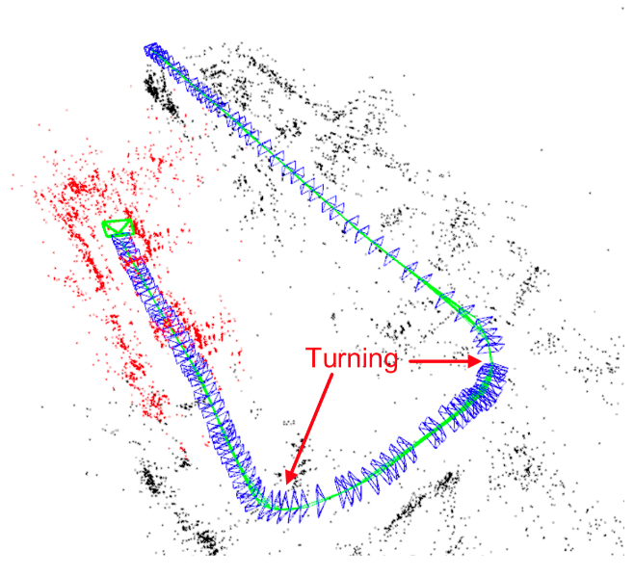
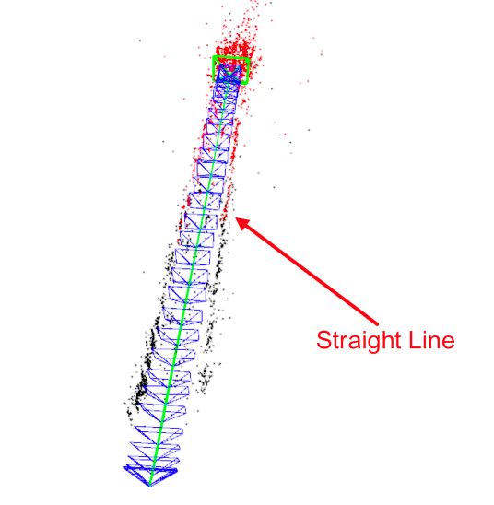
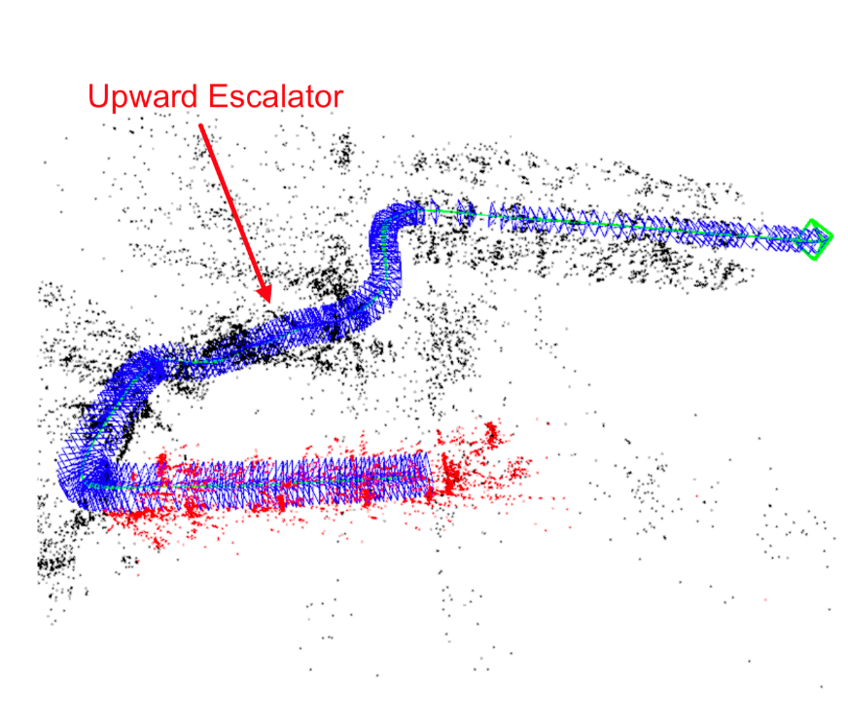
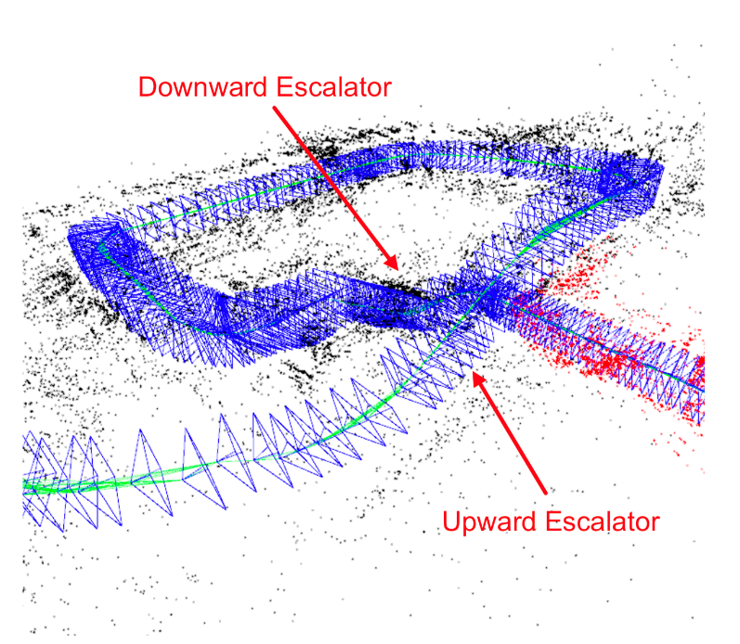
Experiments: Trajectories
Notes:
Here are trajectories built from different venues.
The shapes include straight line, turning points, and even upward and downward escalator.

Slide 20
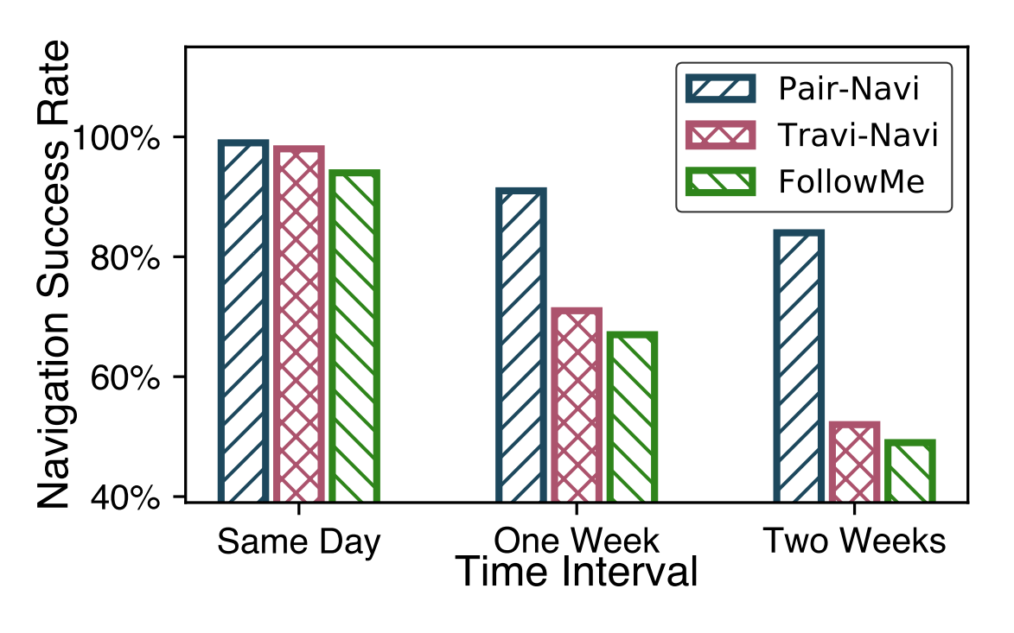
Experiments: Results
Overall Navigation Success Rate Comparison
Notes:
The overall navigation success rate of our work outperforms Travi-navi and FollowMe.
Even after two weeks, our system still has higher-than-80% success rate, but Travi-navi and FollowMe falls below 60%.

Slide 21
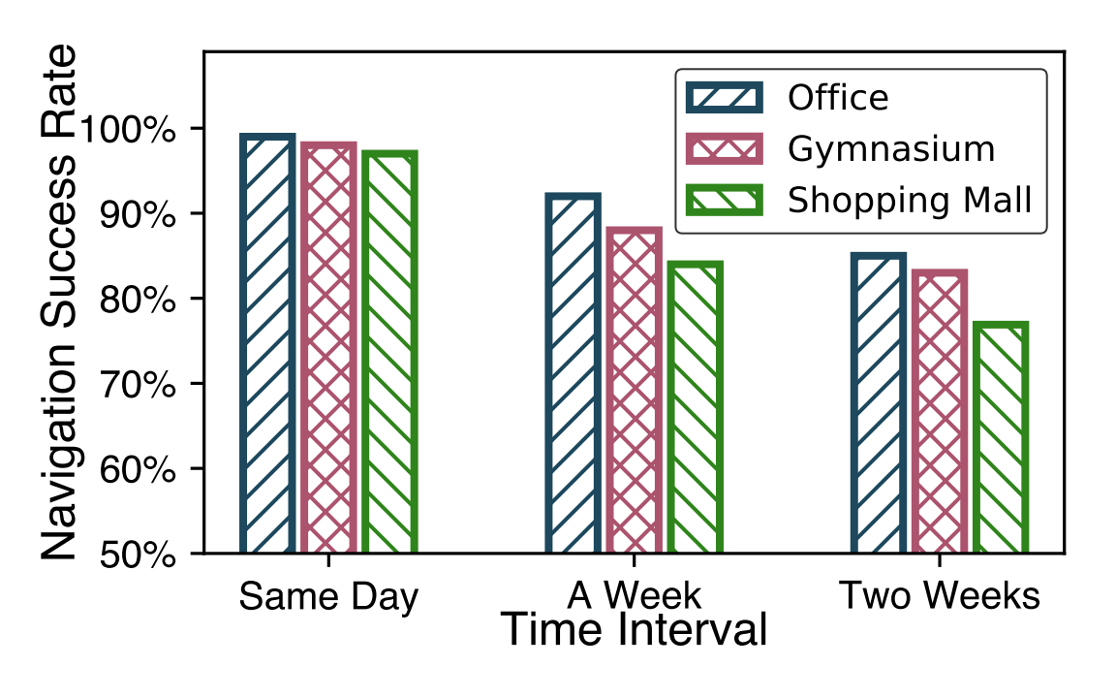
Experiments: Results
Different Environments
Notes:
In various environments, our system performs well, even after two weeks, our system still has a success rate of 75%.

Slide 22
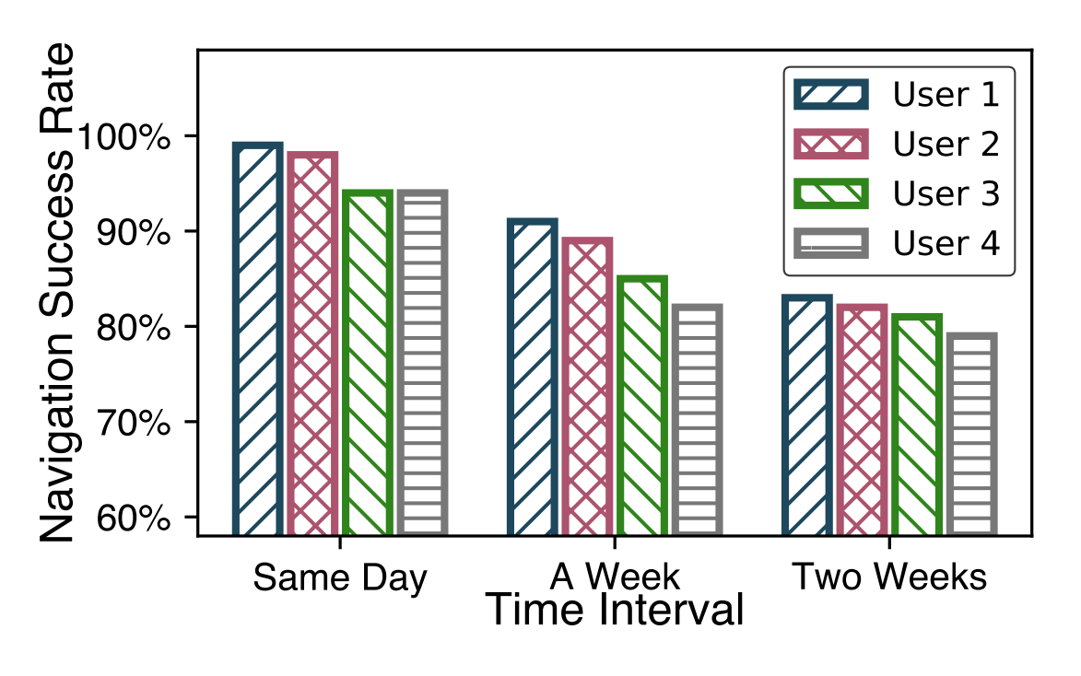
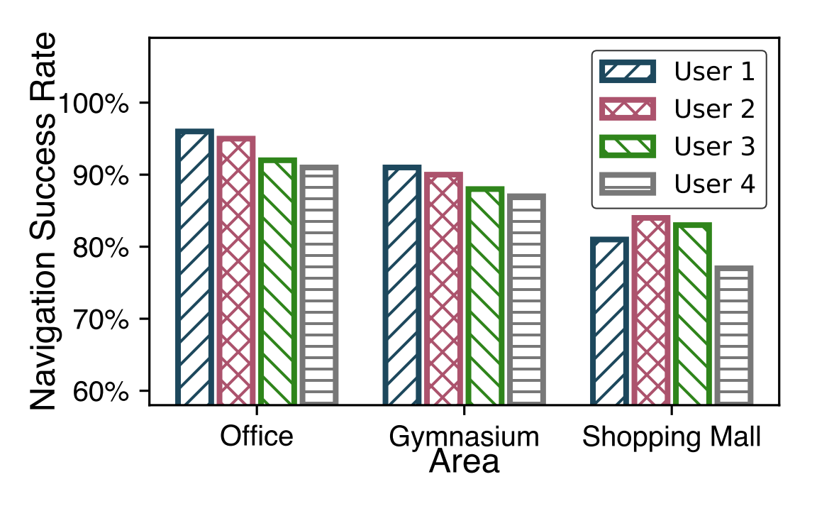
Experiments: Results
User behavior
Notes:
As for user behaviors, we asked 4 users with various height and very different behaviors, some holding the phone steadily, others may have a shaky hand.
And the result suggests it can tolerate different user behaviors in different environments as well as in the long term.

Slide 23
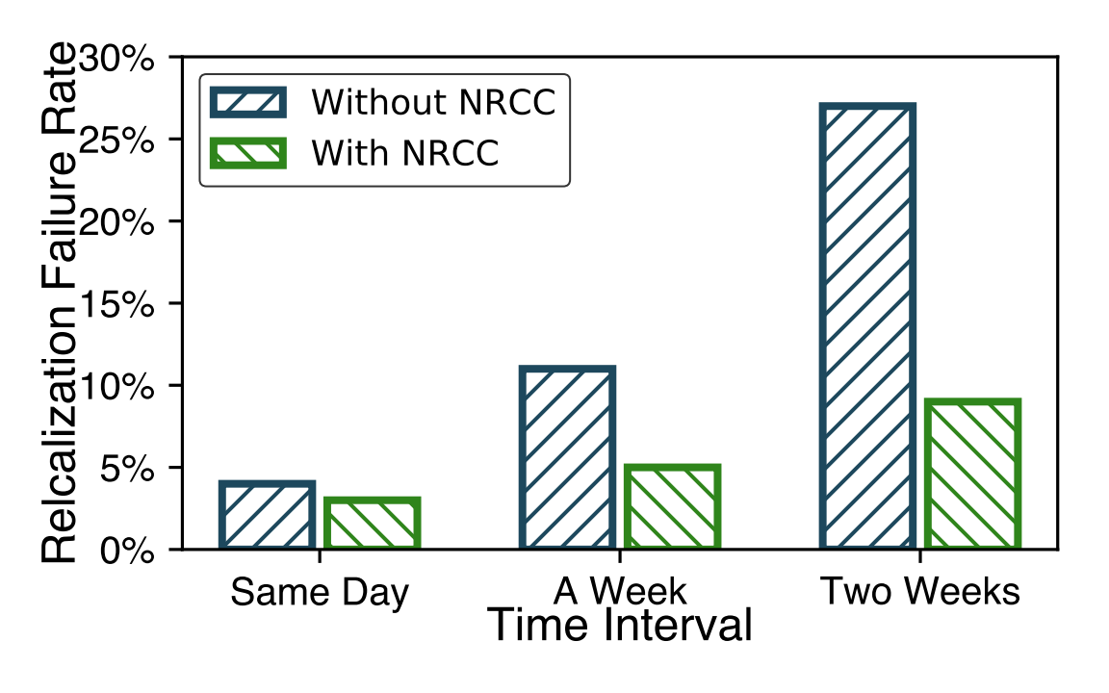
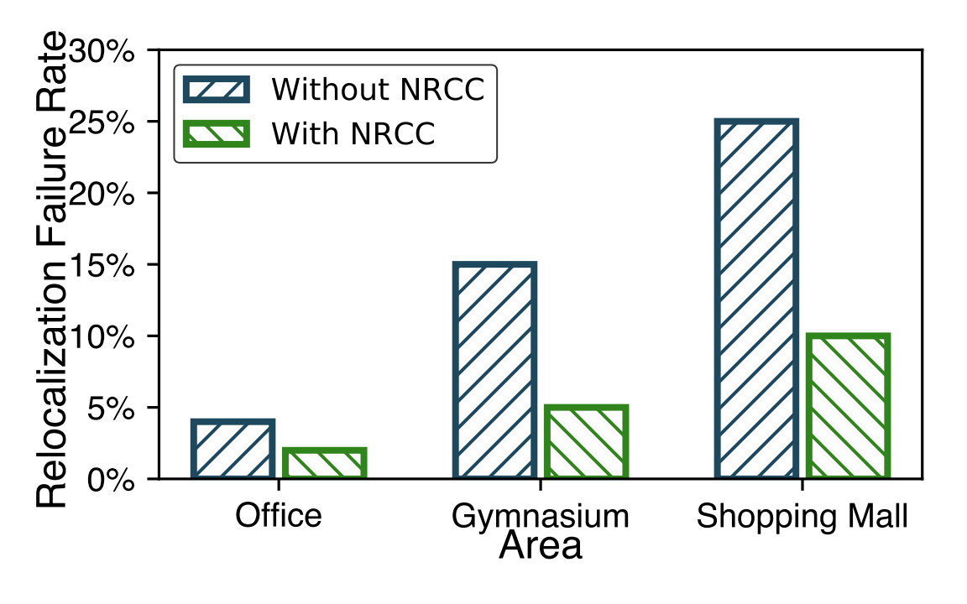
Experiments: Results
Impact of Non-rigid Context Culling
Notes:
We also evaluated the impact of non-rigid context culling.
The relocalization failure rate of the follower drops saliently with NRCC, which demonstrates its superiority.

Slide 24
Conclusion
Pair-Navi is a P2P visual navigation system
Real-time
Robust in non-rigid environment
Fail-safe because it handles deviation
User-friendly
Pair-Navi achieves delightful performance
Works in different environments
Compatible to different user behaviors
Maintain performance in a long time

Slide 25
Thanks!
Q&A
Erqun Dong & Jingao Xu
Tsinghua University
doneq13@gmail.com
xujingao13@gmail.com

